Slide 1
Introducing…
Isaac Jordan - 2080466J,
Jack Croal - 2062685C,
Callum Nixon – 2072704N,
Ben Jackson – 2088051J
Group A4
Notes:
Callum

Slide 2
Grub Grabber
Notes:
Callum

Slide 3
Aim
To provide an application that is accessible to all online which provides users with personalised recommendations for places to get food.
Notes:
Callum

Slide 4
Main Features
Immediate food location recommendations, whether or not you have signed up.
Takes into account what other people have rated if you are similar users (like the same places).
Uses familiar Google Maps API to provide directions and maps.
Provides links to menus, and price lists.
Notes:
Callum

Slide 5

Persona – Steven Jacobs
35 years old
PHD student studying philosophy
Lives in Glasgow
Single and doesn’t have many friends
“I can’t be bothered setting up any accounts”
“I love a cheeky Nandos”
- Steve’s studies take up a lot of his time so when he has time to eat lunch he will want it to be quick to get and eat.
- Having lots of spam emails already filling up his inbox, Steve does not want to give his information away to another website.
- Steve generally only eats vegetables on special occasions, and happily eats unhealthy food if it saves him time and money.
- Being a student, money can be tight, so being able to find the cheapest places to eat nearby would make his life easier.
Notes:
Jack

Slide 6
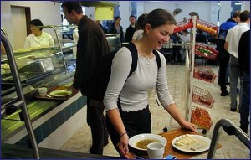
Persona – Harriet Cole
23 years old
Recently graduated into an office job
In long distance relationship
Big foodie
Lives in London
Loves social media
“I don’t eat the same cuisine 2 days in a row”
“Presentation really makes a good dish great!”
Harriet works in a boring office, her lunch is at the same time every day. She wants daily food suggestions on time every day.
Due to expensive house prices she tries to save what money she can, however this doesn’t stop her spending money on nice, varied food once in a while.
Harriet eats out for lunch every day she is working but being in a new city struggles to find the right place for her to eat as she enjoys eating a variety of cuisines.
She’s a big Facebook user, so obviously doesn’t care about giving her personal information away by registering for Food Finder.
Notes:
Jack

Slide 7
Specification
Takes location (street/postcode) from user if they don't have an account.
Recommends food vendors based on ratings and location in relation to user.
Gives information on the recommended vendor based on Google Maps API (reviews, menu, pricelists).
Stores a log of decisions (favourite, eat, dismiss, blacklist) made by the user in order to make sure vendors they don’t like don't come up again, and that they don't get the same places too many times in a few days.
Users can create an account to store preferences and locations.
Notes:
Ben

Slide 8
Specification - MoSCoW
Must | Personalised food recommendations based on ratings and location of the user Be easy to use, with no unnecessary time wasted (i.e. no need for login) Use a maps API for location, directions and reviews Take location from user if they don’t have an account
Should | Store suggestions made Stores suggestions made to user and choices made by the user in order to make sure places they don’t like don't come up again, and that they don't get the same places twice in a few days -doing this by thumbs up or down (if user is logged in) Allow user to ‘blacklist’ and ‘favourite’ vendors (if user is logged in)
Could | Provide automatic scheduled emails for recommendations Take into account what other people have rated Price range rating for each vendor Ability to view your friends accounts Provide links to the vendors menu Social network integration (i.e. Facebook) to share your lunch location
Won’t | Place orders for you Retrieve location using GPS or IP
Notes:
Ben

Slide 9
User Needs Matrix
Features | Steven Jacobs (quick, no login) | Harriet Cole (variety, registers)
Favourites/Blacklist | 2 | 8
Stores suggestions to avoid repeats | 3 | 9
Remember user’s location | 2 | 9
Displays price range | 8 | 4
Provides map to vendor | 9 | 9
Social media Integration | 0 | 6
Ability to view friends | 0 | 6
Notes:
Ben

Slide 10
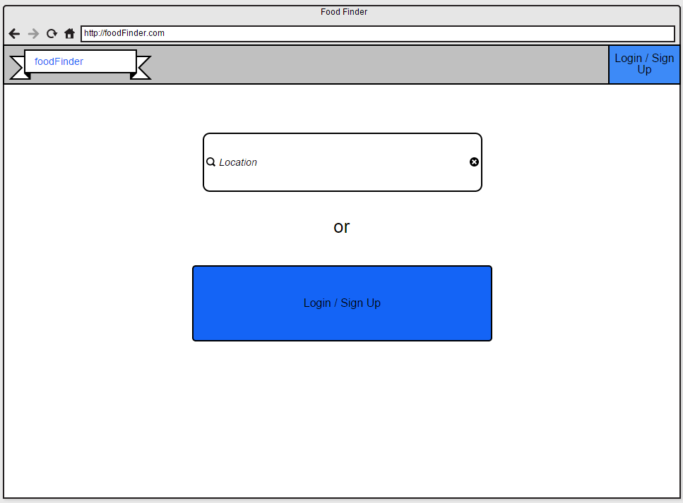
Grub Grabber
Text field for entering current location
Only shown if not logged in
Notes:
Jack

Slide 11
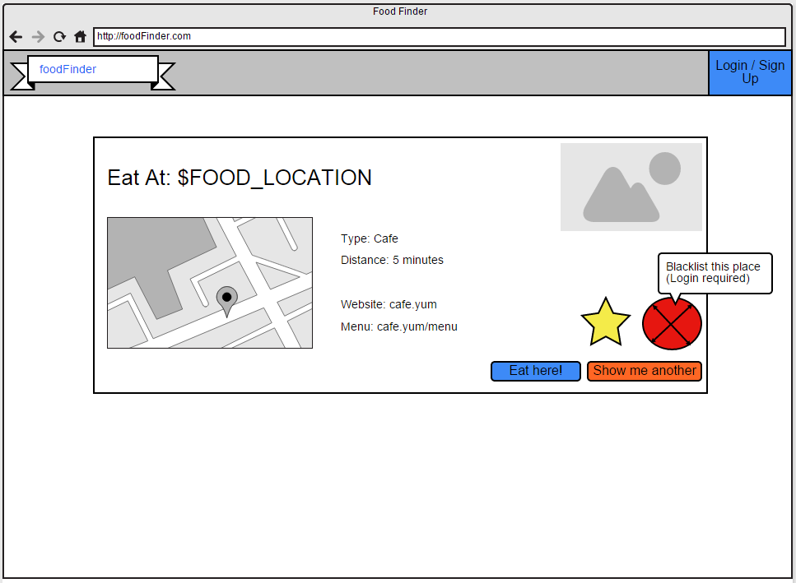
Grub Grabber
Favourite a food vendor (requires log-in)
Select a food vendor
Dismiss and show next food vendor
Blacklist a food vendor (requires log-in)
Tooltip upon hover
Notes:
Jack

Slide 12
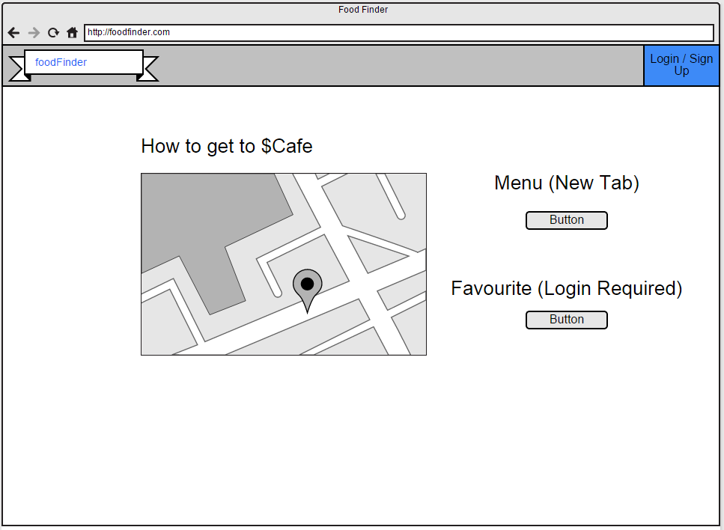
Grub Grabber
Links to food vendors menu
Map from current location to food vendor
Adds the food vendor to favourites if logged in
Notes:
Jack

Slide 13
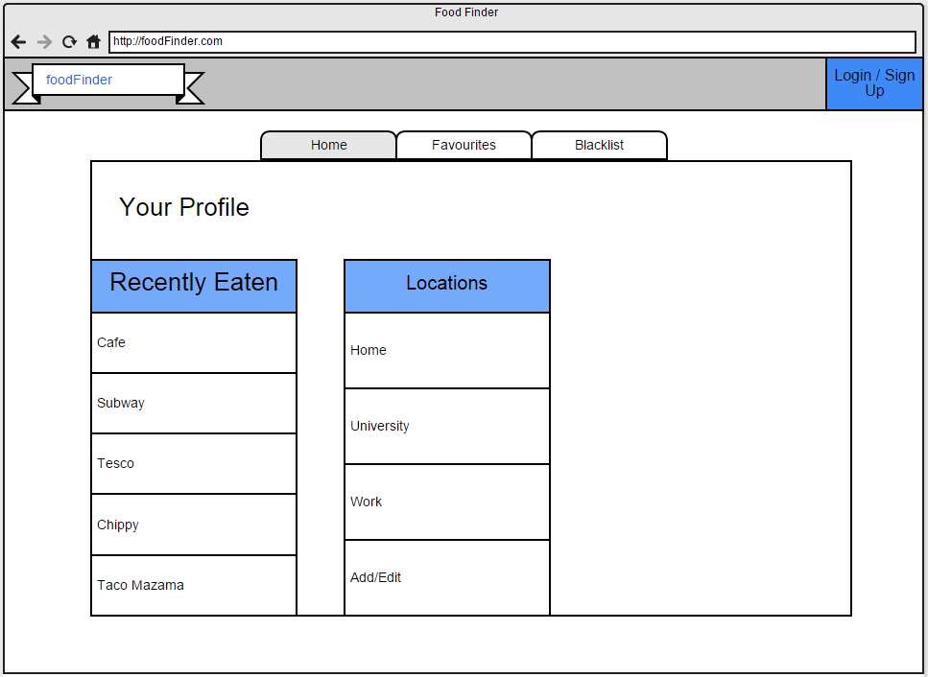
Grub Grabber
Tabs to cycle through pages
Notes:
Jack

Slide 14
URL MAP
http://grubgrabber.com/login/
http://grubgrabber.com/register/
http://grubgrabber.com/
http://grubgrabber.com/search/
http://grubgrabber.com/profile/
(accessible from anywhere if logged in)
http://grubgrabber.com/search/
(with POST data)
http://grubgrabber.com/place/<PLACE_ID>
Notes:
Isaac

Slide 15
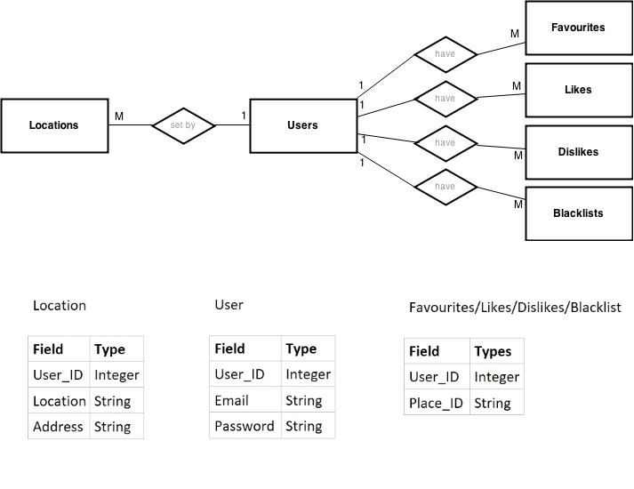
Entity-Relationship Diagram
have
have
Set by
have
have
Notes:
Isaac

Slide 16
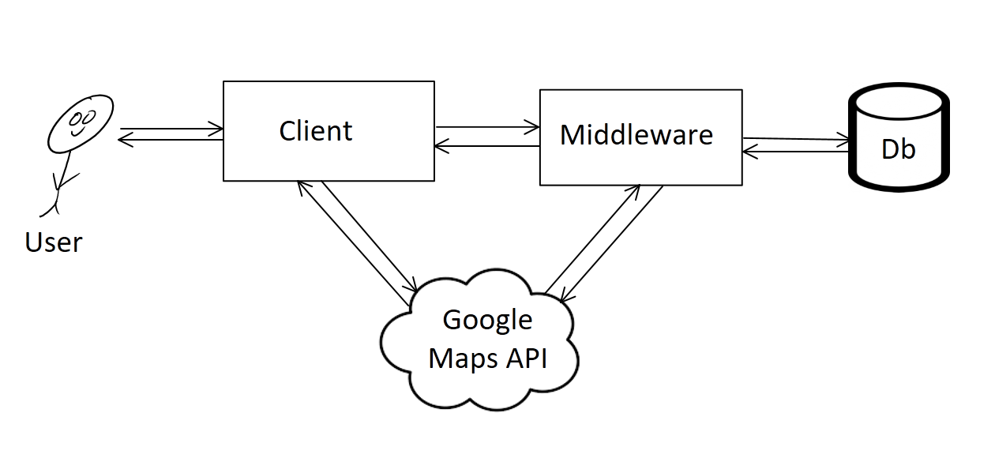
System Architecture
Notes:
Isaac

